Slide 1

Tower Pulse
Streaming data system for cell Towers operational and maintenance coverage
Data Engineer Track - R1 2026
Minya Branch

Slide 2






Our Team

Slide 3

Tower Pulse Overview
Tower Pulse is an end-to-end telecom monitoring platform designed to track and analyze cellular tower performance using both historical and real-time data.

Slide 4

Business Case
Key Challenges:
Delayed detection of tower failures
High call drop rates and poor user experience
Reactive maintenance and rising operational costs
Lack of real-time visibility
The 5G rollout signifies a revolutionary shift in connectivity, enhancing speed and reliability. Coupled with the integration of IoT devices, telecom companies are poised to unlock new potentials in automation, smart cities, and real-time data analytics. This synergy creates vast opportunities for innovation and customer engagement in various sectors.

Slide 5
Why Tower Pulse?
Tower Pulse enables:
Live monitoring and early anomaly detection
Faster operational response
Reduced downtime and improved QoE
Smarter, data-driven maintenance decisions

Slide 6
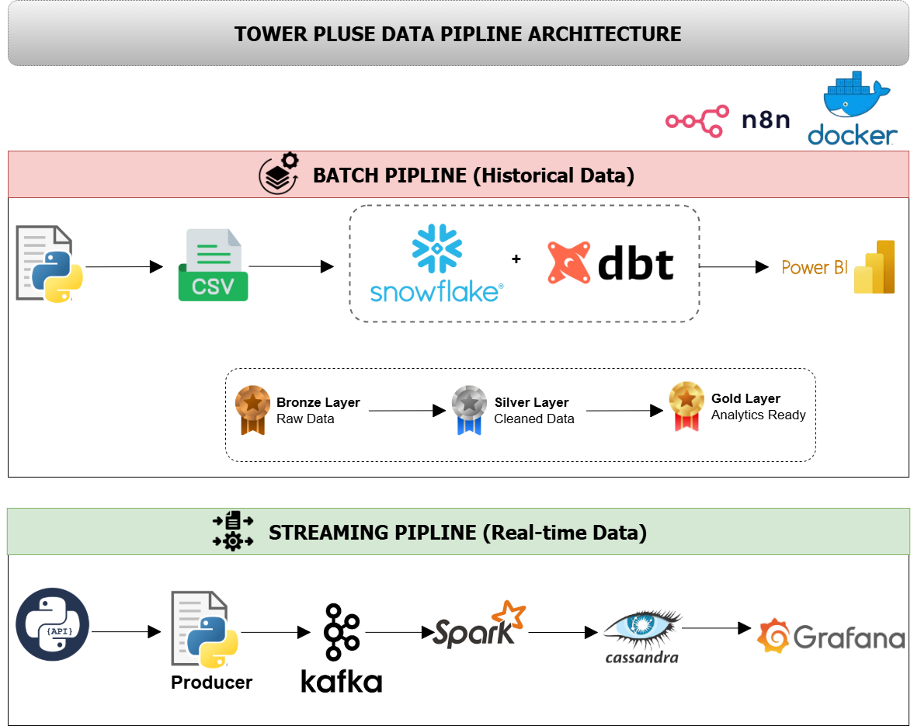
End
to
End
Pipeline
Architecture

Slide 7
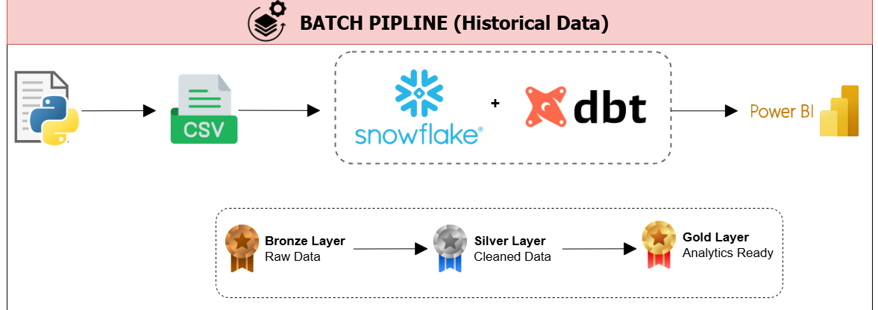
Batch Pipeline
analytics for long-term cell Towers performance and maintenance coverage

Slide 8




Batch Pipeline
Data Ingestion

Slide 9
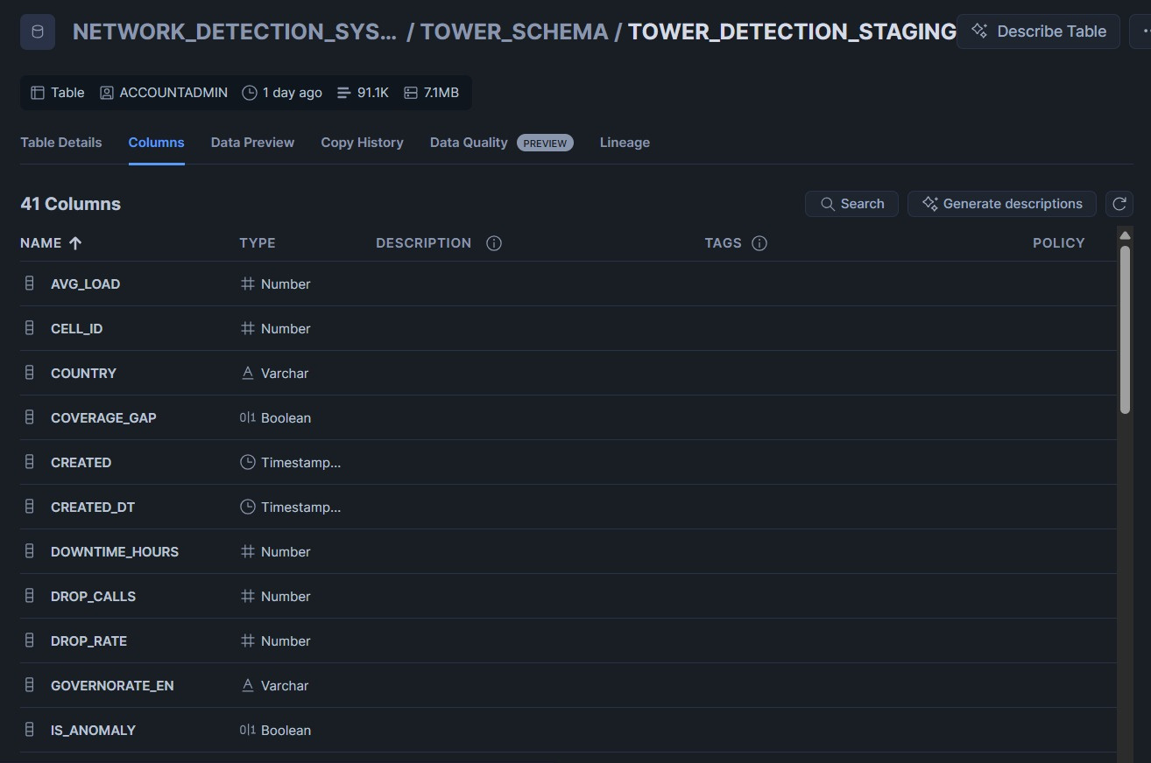
Batch
Pipeline
Staging in Snowflake

Slide 10

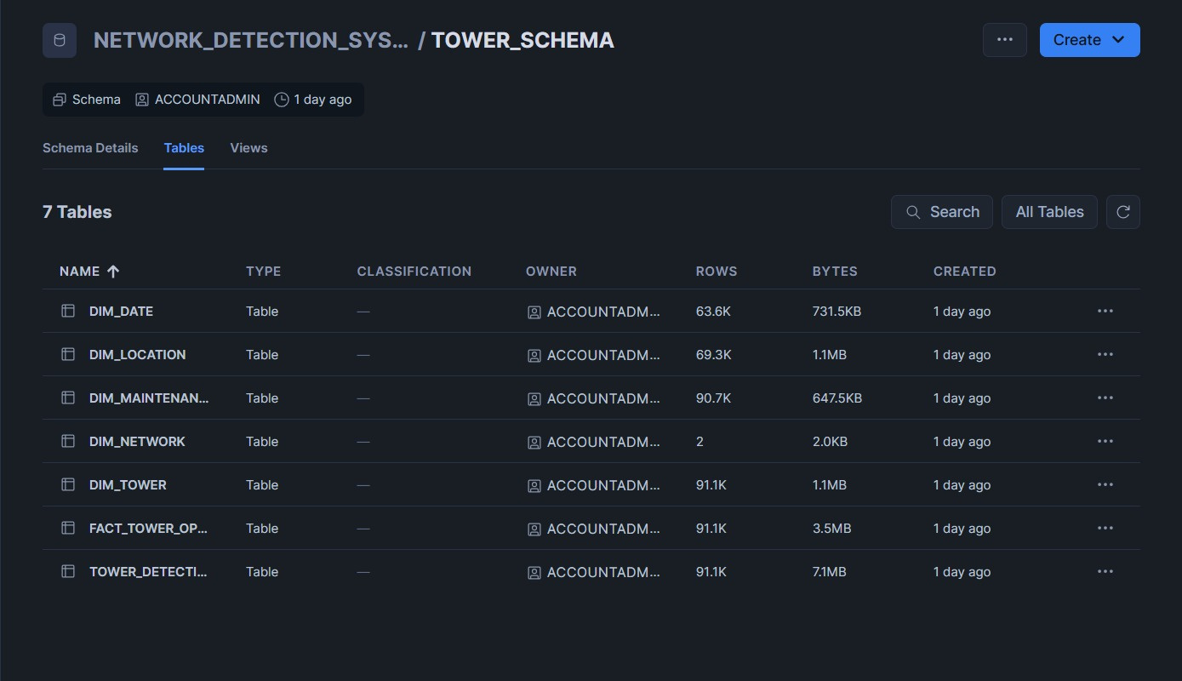
Snowflake

Slide 11
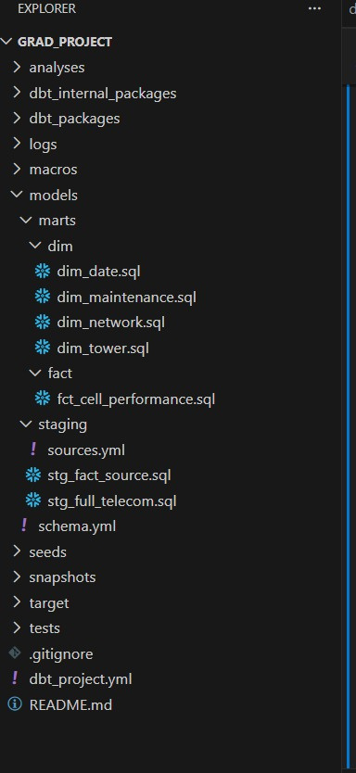

dbt

Slide 12
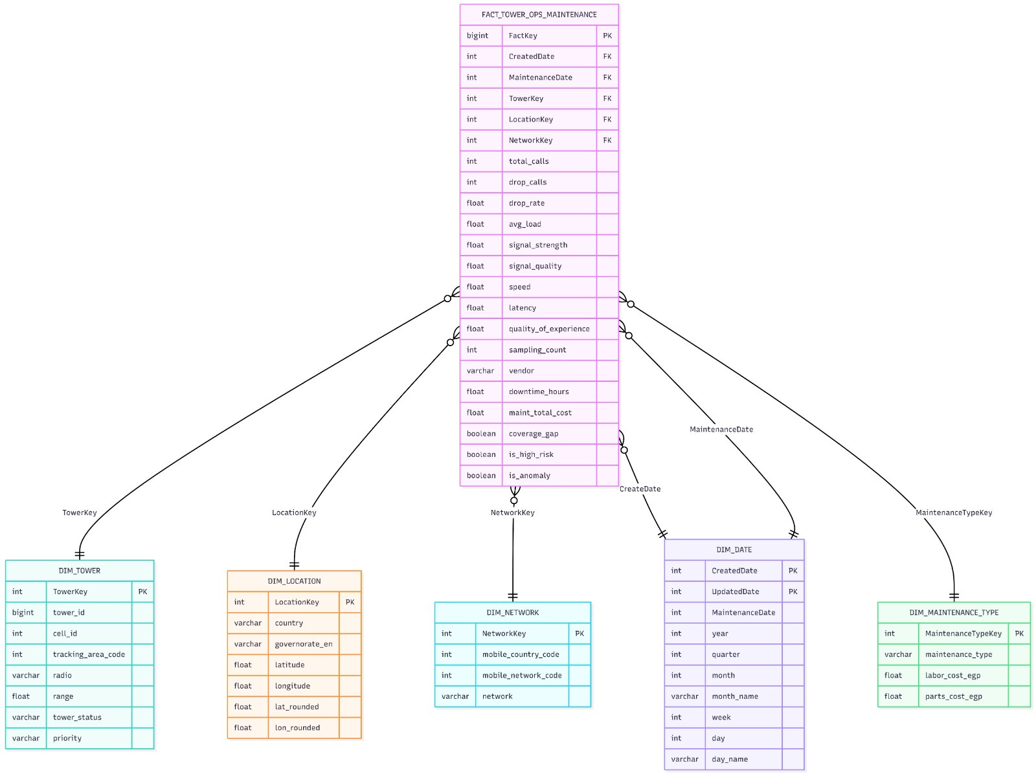
Data Warehouse
Model
Star Schema

Slide 13
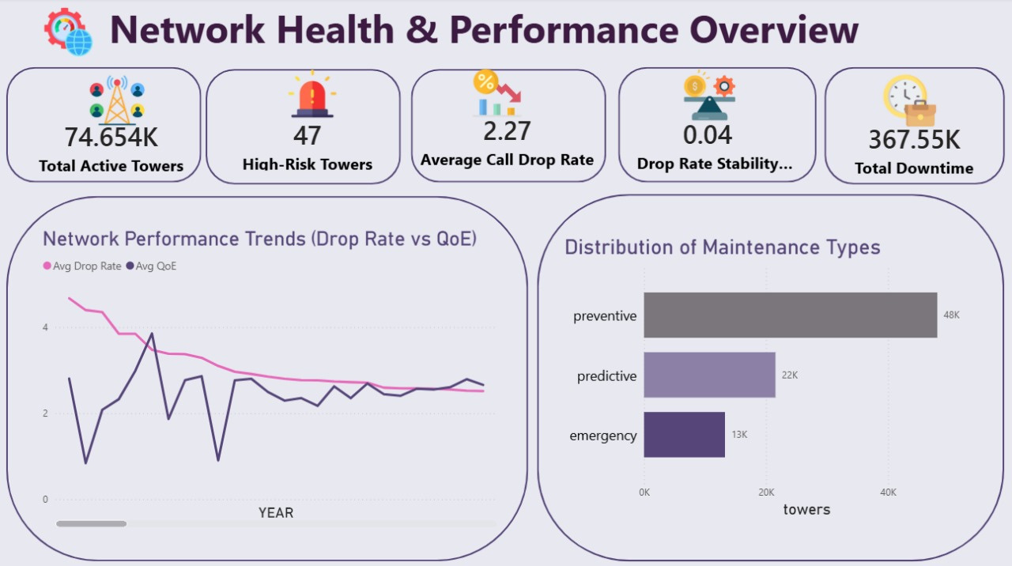

Slide 14
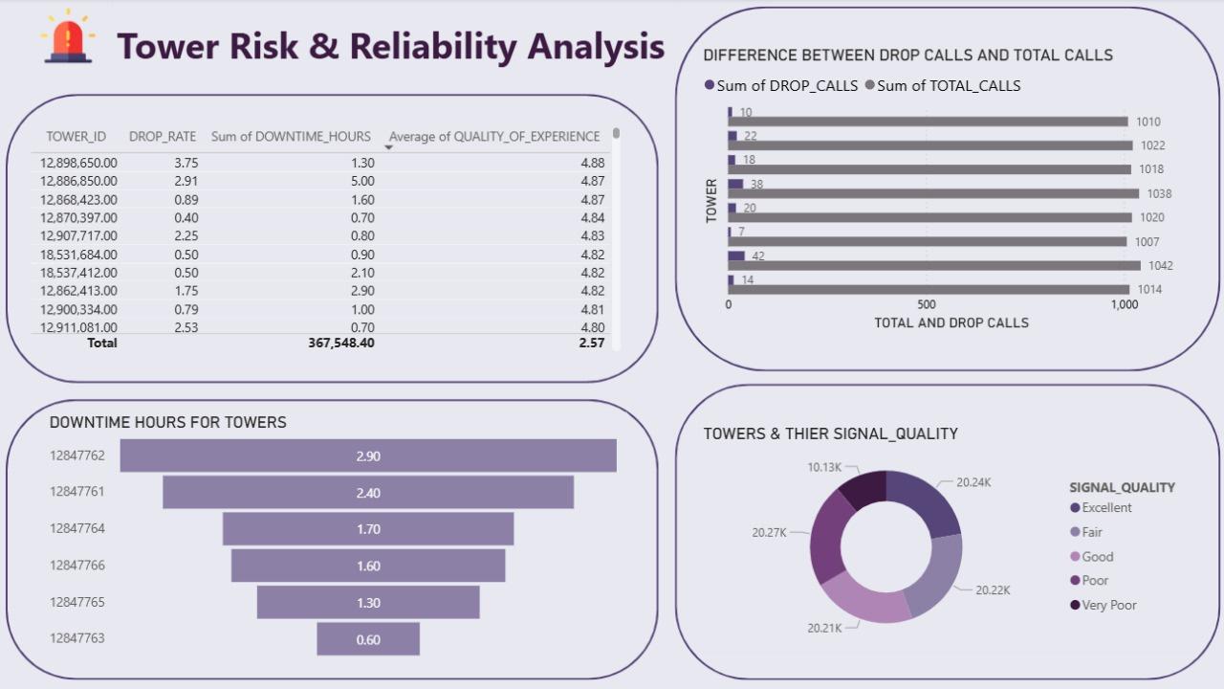

Slide 15
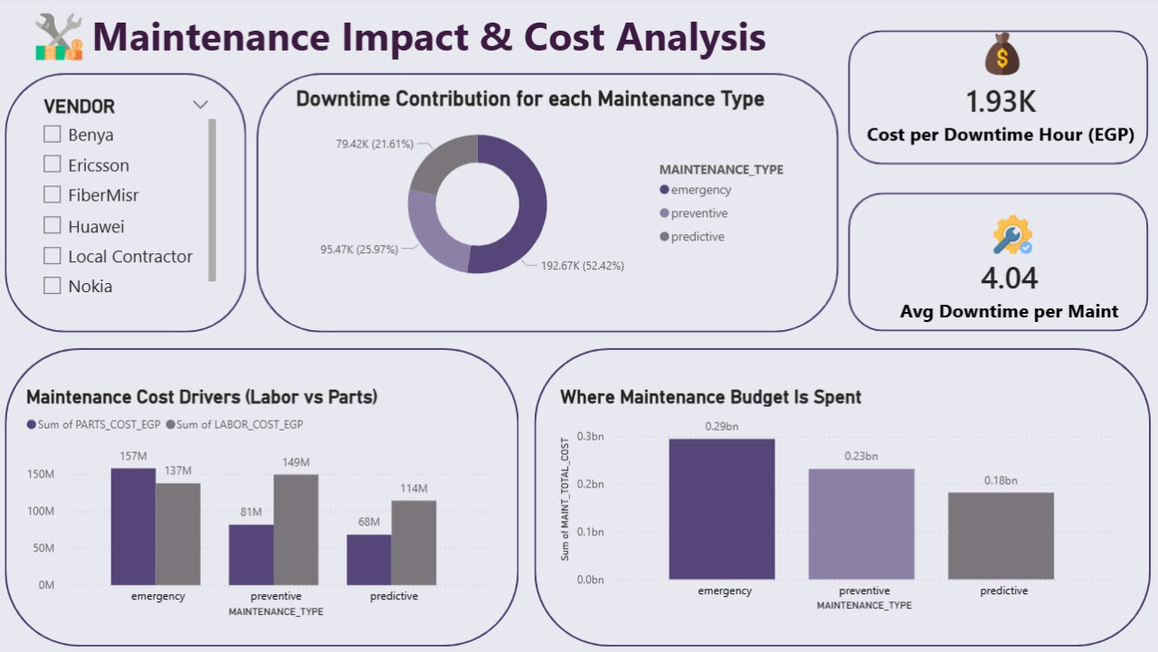

Slide 16
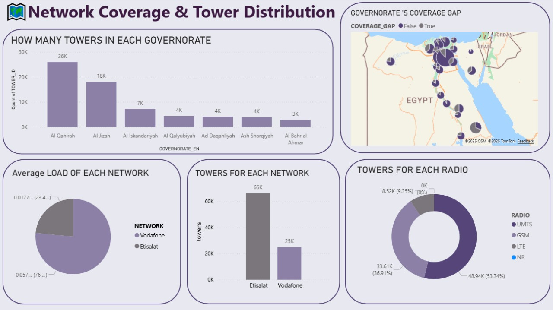

Slide 17
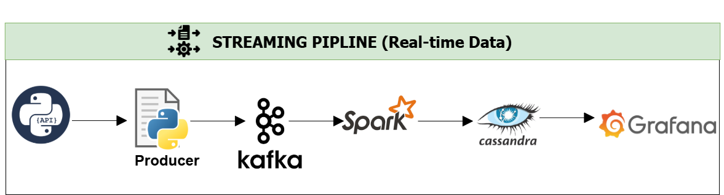
Streaming Pipeline
analytics for live issue detection , cell Towers performance and maintenance coverage

Slide 18


Streaming Layer
Producer
Topic

Slide 19
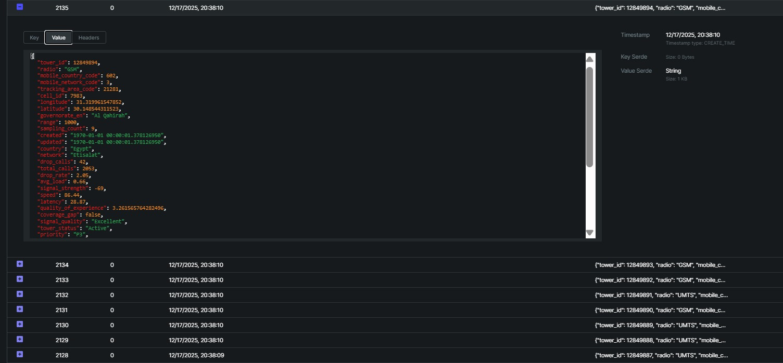

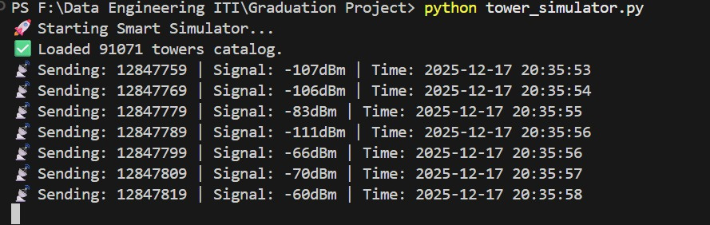
Streaming Layer
Raw Data
Producer

Slide 20

Streaming Layer
Spark Streaming Data Transformation
Ingests parsed real-time tower data (df_parsed)
Calculates total maintenance cost per tower
Flags high-risk towers based on performance KPIs
Detects anomalies caused by extreme network behavior
Standardizes timestamps for time-series analysis
Prepares geospatial fields for map-based visualization

Slide 21
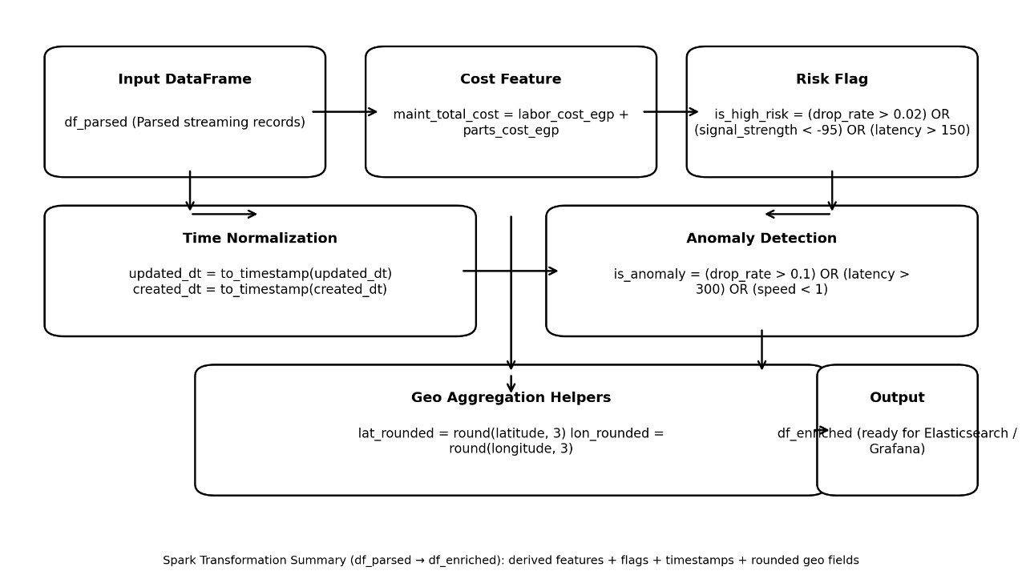
Streaming Process

Slide 22

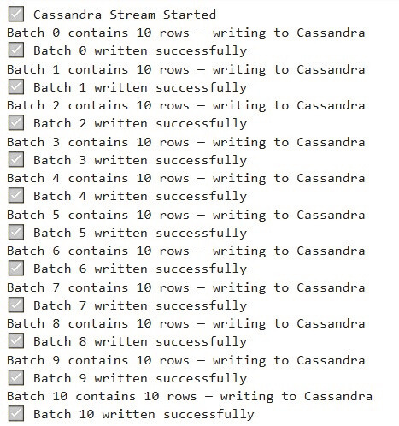
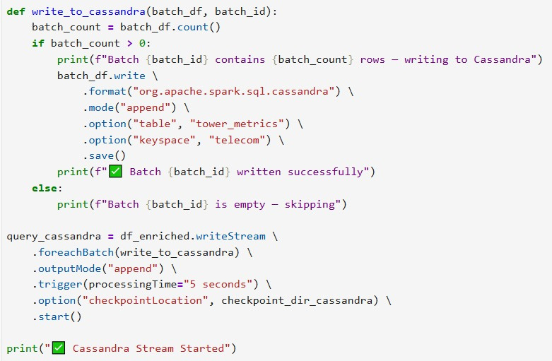

Cassandra

Slide 23

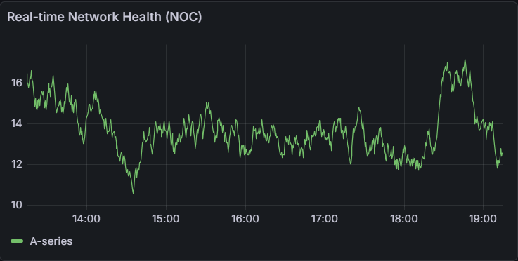
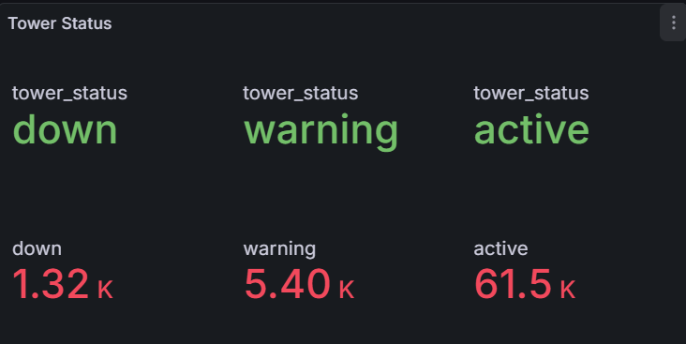
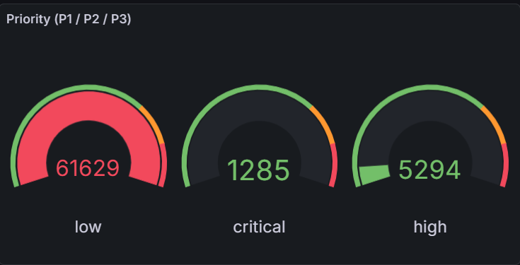
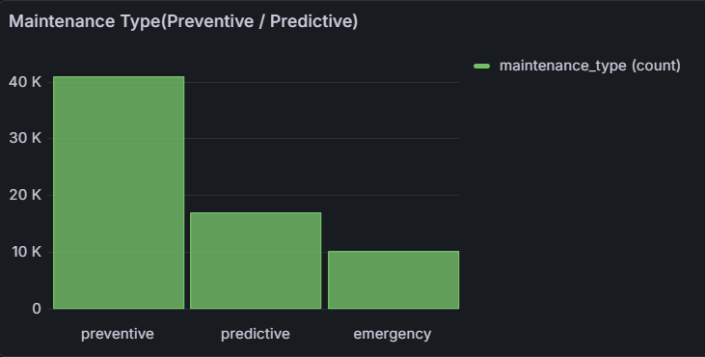

Slide 24
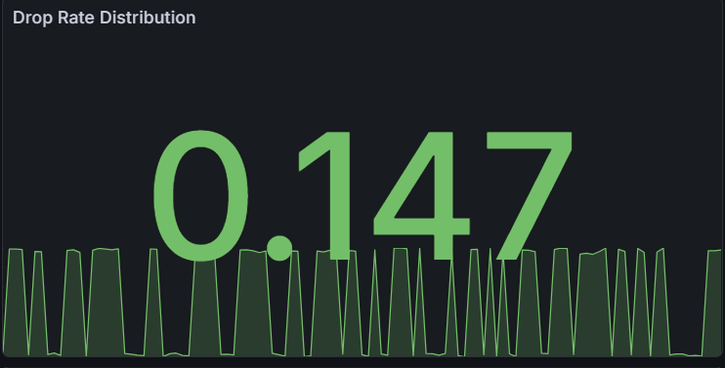
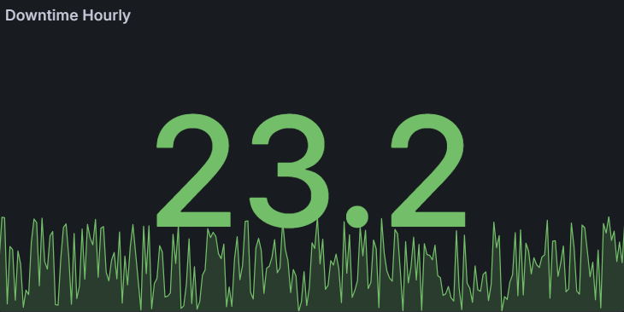
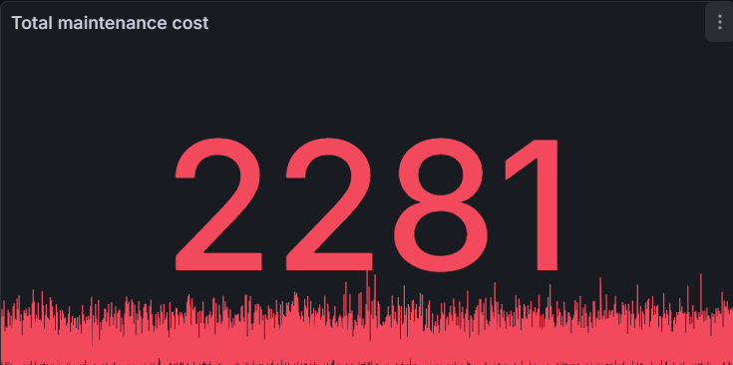
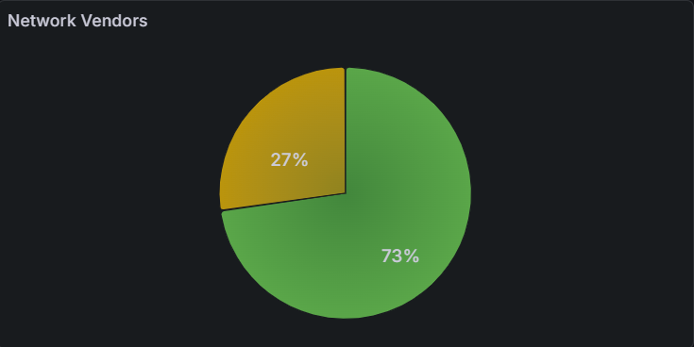
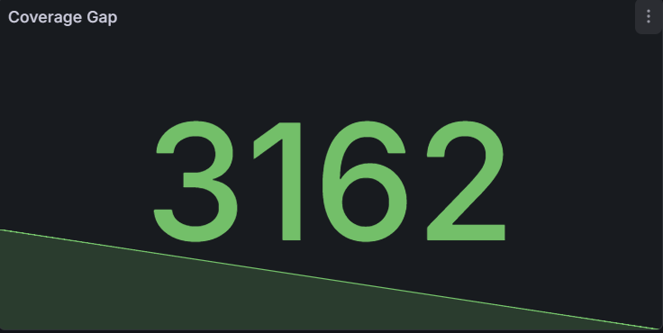

Slide 25
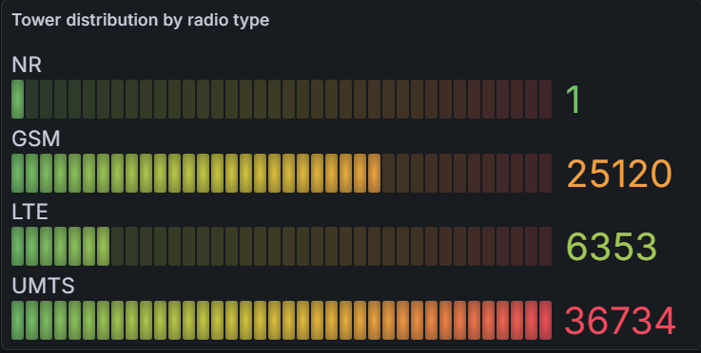
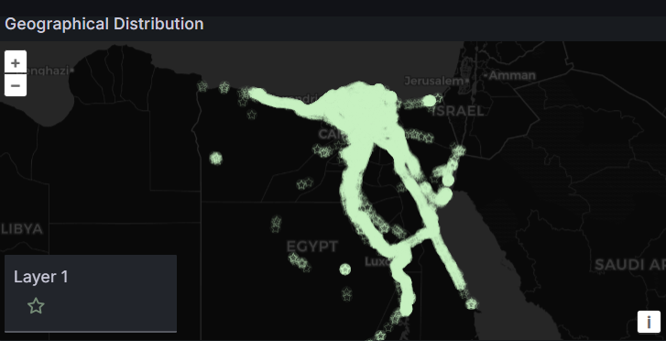
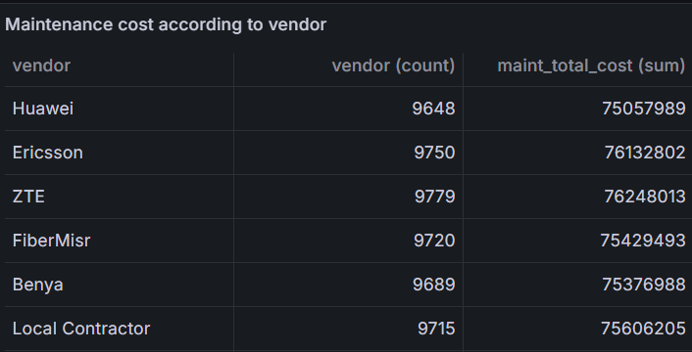
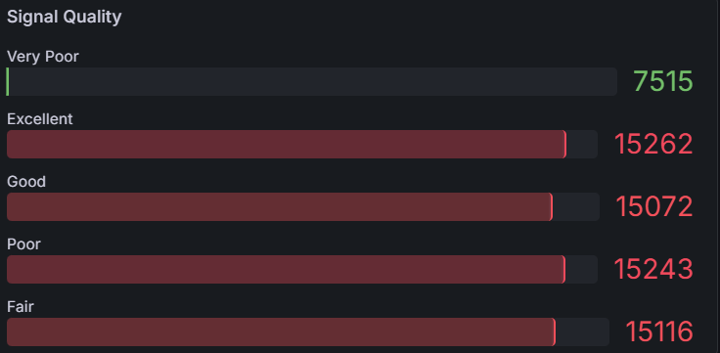

Slide 26

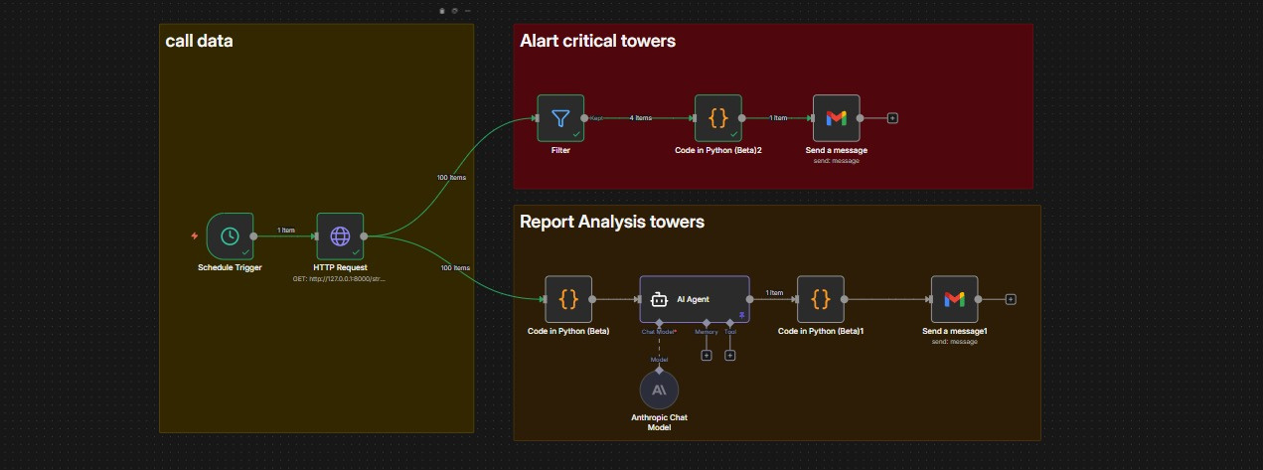
workflow automation

Slide 27
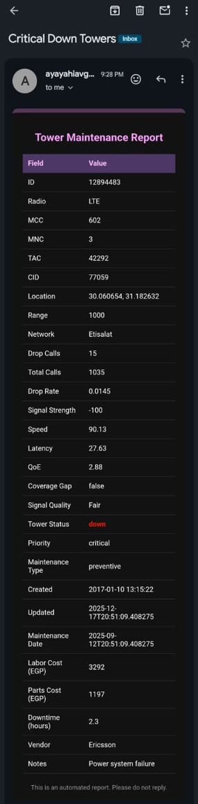
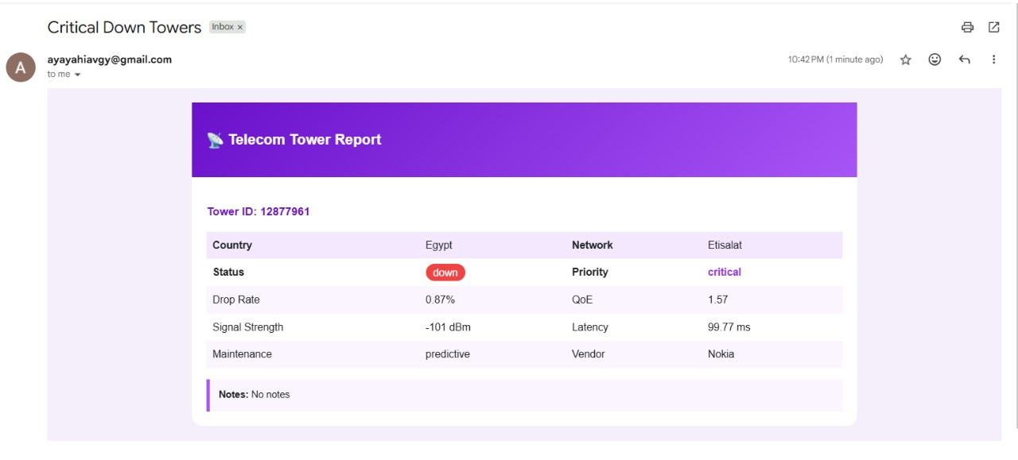
Telecom Tower Report

Slide 28
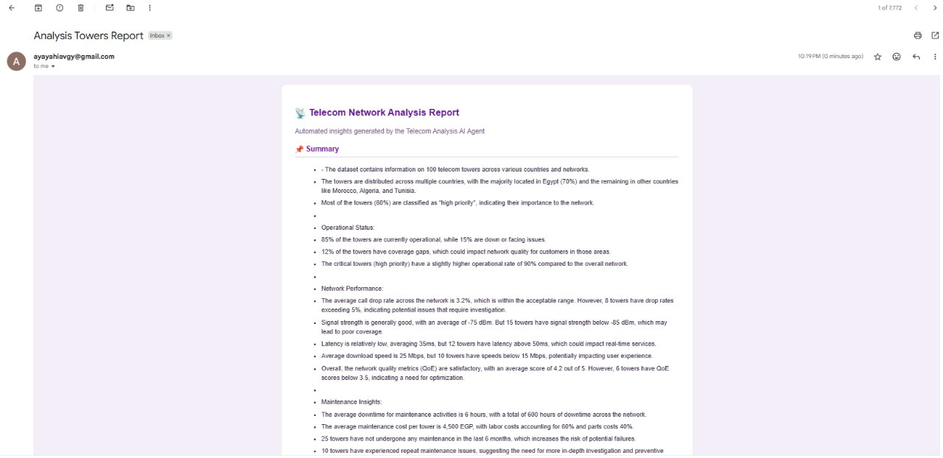
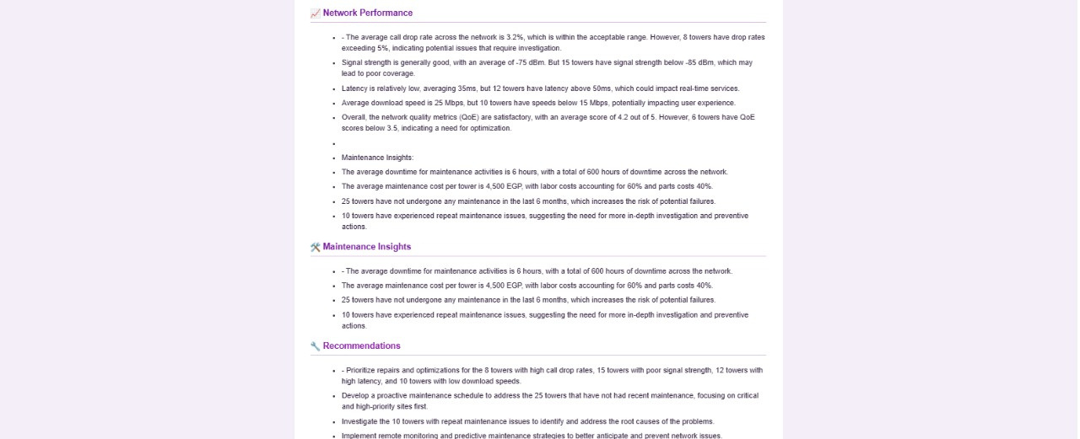

Report Analysis

Slide 29


